Slide 1
Stroke Syndromes
Jason Massa D.O.

Slide 2
Learning Objectives
Explain the different categories of ischemic and hemorrhagic stroke
Interpret the symptoms and signs present in stroke patients
Explain the most frequent syndromes produced by cerebrovascular disease
Apply the acquired knowledge to clinical examples, with a focus on localization

Slide 3
Contents
Definition of stroke
Classification
Anterior Circulation Syndromes
Posterior Circulation Syndromes
Blood Supply Review
Small Vessel Syndromes

Slide 4
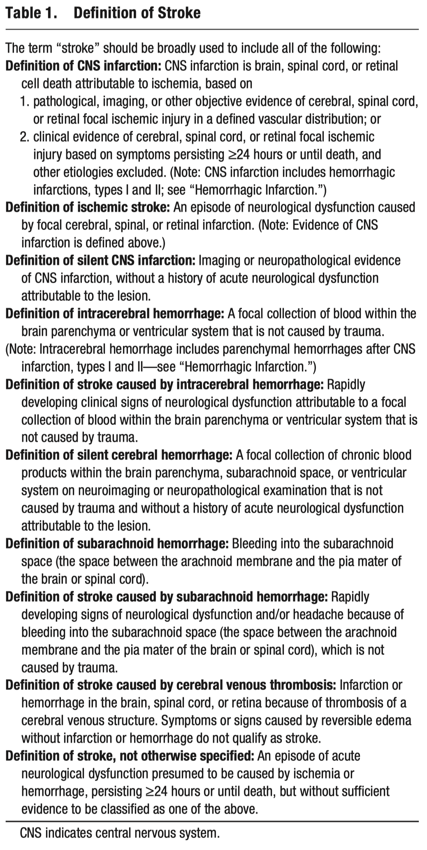
What is a Stroke?
“Infarct of the brain, spinal cord, or retinal cell death attributable to ischemia…”
Broad definition includes:
Ischemic stroke
Hemorrhagic stroke
‘Silent’ strokes
Venous infarcts
Stroke, NOS

Slide 5
Classification of Strokes
Ischemic
Deprivation of oxygen carrying blood supply rapidly causes damage to neural tissue
Arterial occlusion
Venous occlusion (see clinical stroke lecture)
Hypotension -> hypoperfusion
Hemorrhagic
Intracerebral (intraparenchymal) Hemorrhagic (ICH)
Subarachnoid hemorrhage (see clinical stroke lecture)
Subdural and epidural hemorrhage (see neurologic emergencies lecture)

Slide 6
Classification of Stroke - Ischemic
Large vessel occlusion
Blockage of a large, named artery such as the middle cerebral artery
Can be due to embolism or stenosis leading to occlusion
Anterior circulation:
ACA and MCA syndromes
Posterior circulation:
PCA, Basilar artery syndromes

Slide 7
Classification of Stroke - Ischemic
Small vessel occlusion
AKA lacunar infarcts
Due to local thrombosis
Small penetrating arteries that branch directly from large vessels must handle a large increase in vessel wall stress, making them vulnerable to thrombosis.
Pure motor, ataxic hemiparesis, pure sensory, dysarthria-clumsy hand, and sensory-motor syndromes.

Slide 8
Classification of Stroke - Ischemic
Hypoperfusion
Watershed infarcts
Seen in patients with precipitous drops in blood pressure
Affects areas of the brain which are in the ‘watershed’ regions between major arterial distributions
These areas lack the collateral blood flow that other areas have, making them vulnerable to the effects of low pressure

Slide 9
Classification of Stroke - Hemorrhagic
Intracerebral Hemorrhage
Bleeding withing the parenchyma of the brain
Chronic degenerative changes of the penetrating arteries
Most common sites are putamen/internal capsule, deep white matter, thalamus, cerebellum, and pons
Large blood volume causes mass effect on surrounding tissue, can lead to herniation.

Slide 10
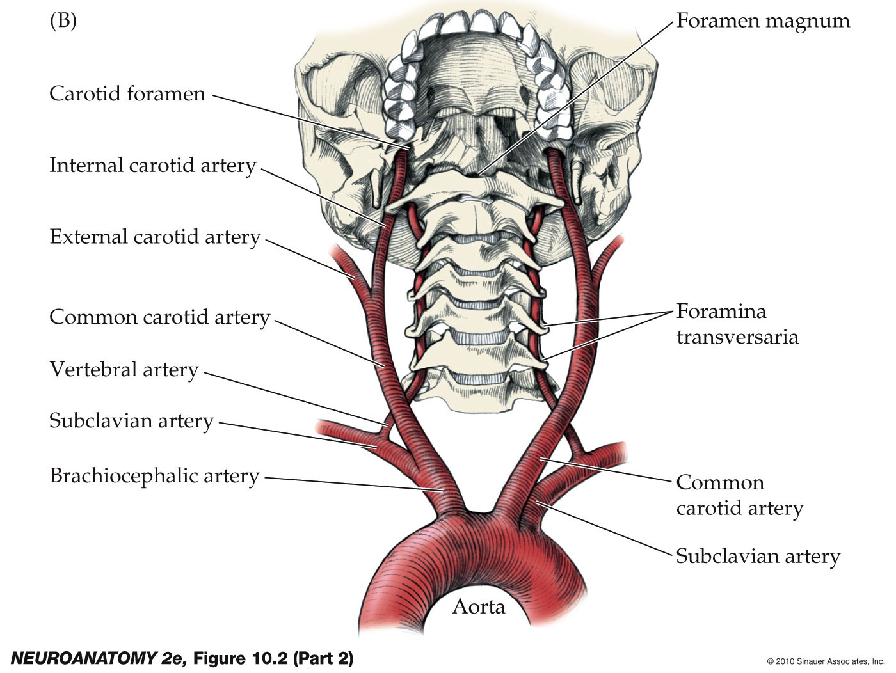
Cerebral Circulation Review
Anterior circulation begins with the carotid arteries
Left common carotid directly off of the aortic arch
Right common carotid is a branch of the brachiocephalic trunk
The Internal carotid supplies the brain
Posterior circulation begins with the vertebral arteries
Bilaterally these are branches off the subclavian

Slide 11
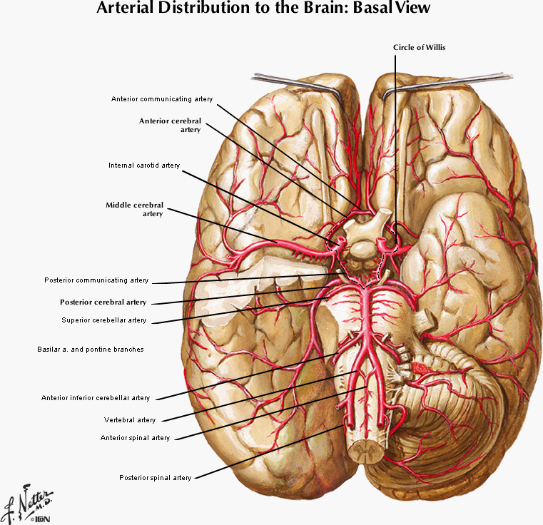
Cerebral Circulation Review
Anterior circulation – ICA branches:
Middle Cerebral Artery
Anterior Cerebral Artery
Lenticulostriate Arteries
Posterior circulation:
Vertebral Arteries
PICA
Basilar Artery
AICA, SCA
Pontine perforating
Terminates into bilateral PCAs

Slide 12
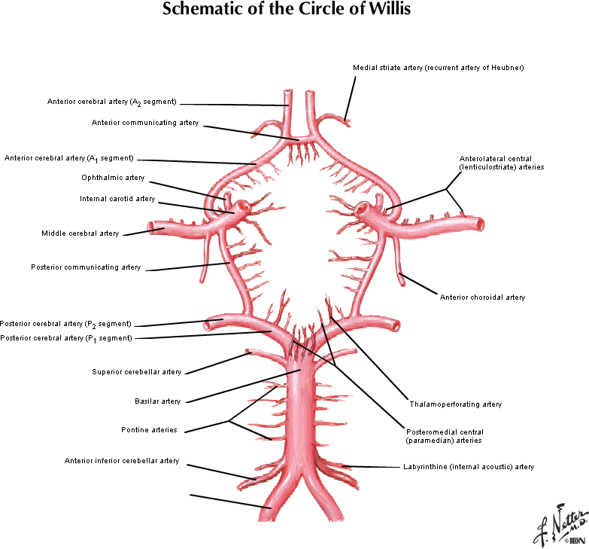
Cerebral Circulation Review
Circle of Willis
Provides redundancy to the cerebral circulation
Anterior communicating artery connects the two ACAs
Posterior communicating artery connects the ICA to ipsilateral PCA
HIGHLY VARIABLE
Common variant: ‘Fetal PCA’
No connection between PCA and the basilar, with the PCA instead fed by the PCOM

Slide 13
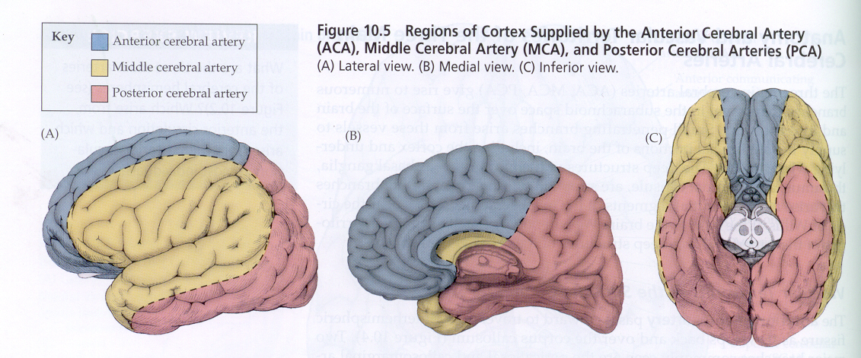
Cortical Vessel Distributions

Slide 14
Anterior Large Vessel Syndromes
Middle Cerebral Artery Syndromes
Proximal occlusion
Distal M1
Superior M2
Inferior M2
Anterior Cerebral Artery Syndrome

Slide 15
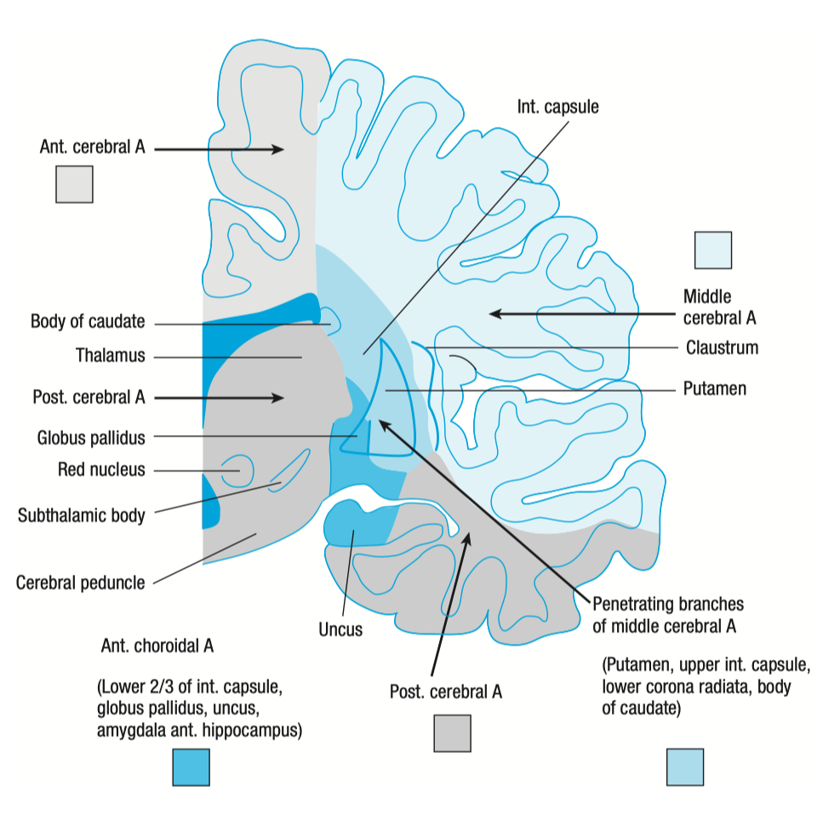
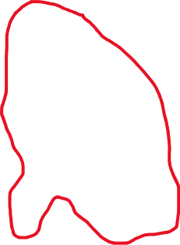
Proximal M1 Occlusion
Occlusion proximal to the origin of the lenticulostriate arteries
Contralateral hemiplegia (body and face)
Hemianesthesia
Contralateral homonymous hemianopia
Ipsilateral gaze preference
Global aphasia – if dominant hemisphere
Severe hemineglect and anosognosia – if non-dominant hemisphere

Slide 16
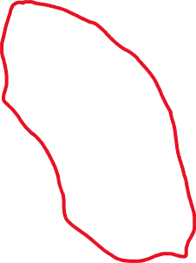
Distal M1 Occlusion
Occlusion distal to lenticulostriate – spares the internal capsule and other deeper structures
Contralateral hemiplegia – face and arm >> leg
Hemianesthesia
Contralateral homonymous hemianopia
Ipsilateral gaze preference
Global aphasia – if dominant hemisphere
Severe hemineglect and anosognosia – if non-dominant hemisphere

Slide 17
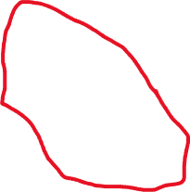
Superior M2
Beyond first branch of MCA
Contralateral hemiplegia – face and arm >> leg
Hemianesthesia
Contralateral homonymous hemianopia
Ipsilateral gaze preference
Broca’s aphasia – initial global
Severe hemineglect and anosognosia – if non-dominant hemisphere

Slide 18

Inferior M2
Beyond first branch of MCA
Less likely to cause contralateral hemiplegia – face, maybe arm, unlikely to affect lower extremities
Can cause contralateral superior quadrantopia
No gaze preference
Wernicke’s aphasia – initial global

Slide 19

ACA Syndrome
Infarcts are usually only seen if occlusion occurs distal to anterior communicating artery
Contralateral sensorimotor deficit in foot and leg
Can cause a transcortical motor aphasia
Urinary incontinence
Contralateral paratonia
Contralateral apraxia

Slide 20
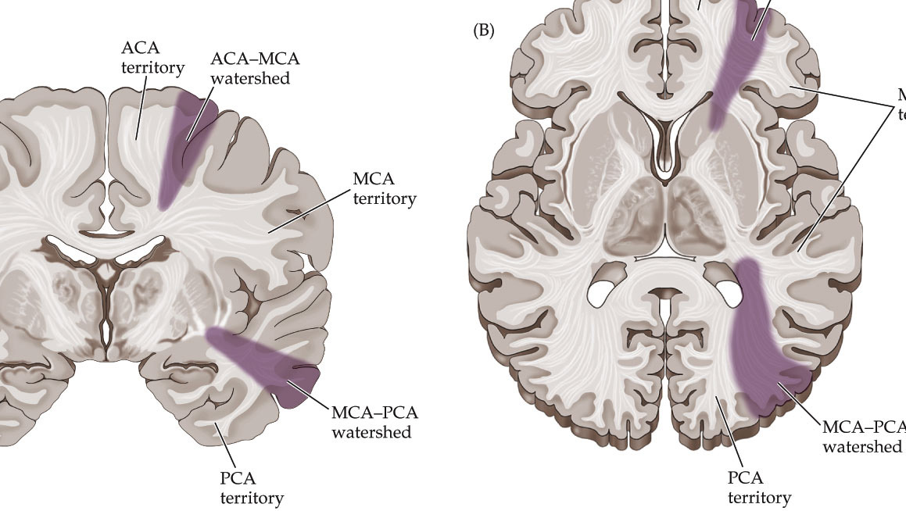
Watershed Infarcts
Vascular territories overlap zones
ACA-MCA
Associated with transcortical motor aphaisa
MCA-PCA
Associated with transcortical sensory aphasia
Often seen after hypotensive events or in patients with many vascular risk factors after surgery

Slide 21
Small Vessel Syndromes
Pure Motor Stroke
Pure Sensory Stroke
Mixed Sensorimotor Stroke
Dysarthria-clumsy Hand Syndrome
Ataxic Hemiparesis

Slide 22
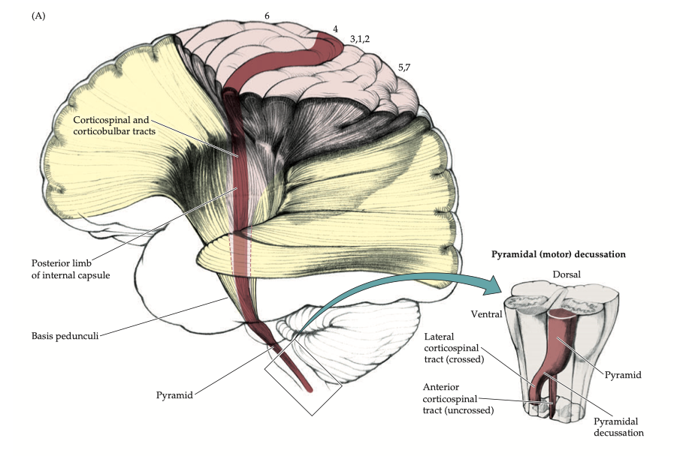

Pure Motor Stroke
Contralateral Hemiparesis
Equal in arms/legs/face
No sensory deficits
No cortical deficits
No neglect
No aphasia
No apraxia
Localization:
Basis Pontis
Posterior Limb Internal Capsule
Corona Radiata

Slide 23
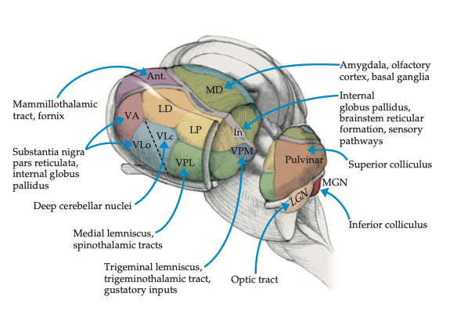

Pure Sensory Stroke
Contralateral Hemianesthesia
Equal in arms/legs/face
No motor deficits
No cortical deficits
Associated with thalamic pain syndrome
Onset of hemibody pain days to weeks after stroke
Localization:
VPL, VPM of thalamus

Slide 24
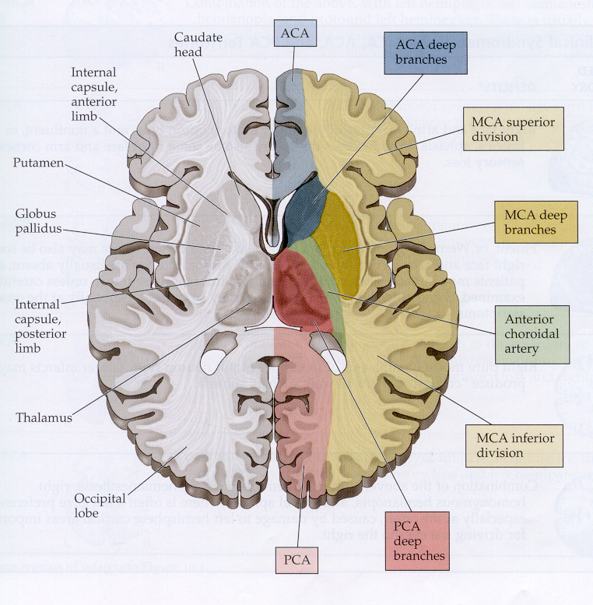

Mixed Sensorimotor
Contralateral Hemiparesis and Hemisensory loss
Equal in arms/legs/face
No cortical deficits
Localization:
Thalamus plus internal capsule

Slide 25
Dysarthria-clumsy Hand
Dysarthria
Contralateral Hand Weakness
No cortical deficits
Localization:
Genu of Internal Capsule
Basis Pontis

Slide 26

Ataxic Hemiparesis
Contralateral Hemiparesis
Contralateral Ataxia
No cortical deficits
Localization:
Internal Capsule
Basis Pontis

Slide 27
Posterior Circulation Syndromes
PCA syndrome
Basilar Occlusion
Brainstem stroke syndromes
Rule of 4s

Slide 28

PCA Stroke
Contralateral Hemianopia
If bilateral, cortical blindness can occur
More rarely Anton’s syndrome – confabulation of sight
Proximal PCA occlusion can affect peduncular perforating branches of PCA:
Midbrain structures
‘Weber syndrome’ – contralateral hemiplegia + ipsilateral oculomotor palsy

Slide 29
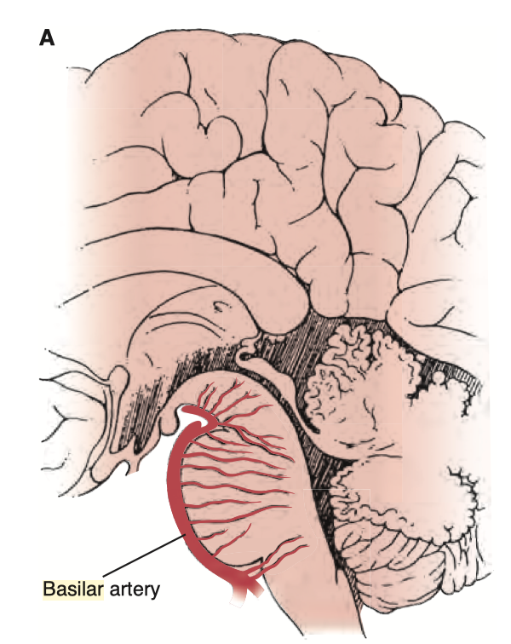

Basilar Thrombosis
Devastating injury to midbrain and pontine structures
Associated with ‘Locked in syndrome’
Patient retains awareness but complete paralysis, with intact sensation
In some cases, only able to make vertical eye movements

Slide 30
Brainstem Stroke Syndromes
The named brainstem stroke syndromes can be overwhelming
The boards (and my exam questions) will always give more than the eponym, either location or blood vessel as an answer choice
A simplified roadmap for dealing with brainstem vascular localization has been proposed by Peter Gates, and Australian neurologist. This is widely used in boards prep
This system utilizes a focus on certain deficits that combine to make a reliable localization

Slide 31
Brainstem Stroke Syndromes Rule of 4
Why it works
The blood supply of the brainstem can be divided into:
Paramedian perforating arteries from the vertebral and basilar artery supplying medial aspects of the brainstem
Circumferential branches that reach the lateral aspects of the brainstem
Four cranial nerves arise from the medulla (12, 11, 10, 9,) and four from the pons (8, 7, 6, and 5,) plus two from the midbrain (4 and 3.)
By utilizing your knowledge of select structures within the brainstem you will be able to localize a brainstem lesion to the level (medulla, pons, midbrain,) and whether it is a lateral syndrome or medial syndrome.

Slide 32
Brainstem Stroke Syndromes Rule of 4
How it works
Paramedian Brainstem contains sets of structures, which can be remembered as starting with ‘M’:
Motor pathways (CST)
Medial Lemnisci (vibration, proprioception)
Medial Longitudinal Fasciculus
Motor nuclei that divide evenly into 12 (3, 4, 6, 12.) All the rest are lateral brainstem
Lateral Brainstem contains structures which can be remembered as starting with ‘S’:
Spinothalamic pathway
Sympathetic pathway
Sensory nucleus of CNV
Spinocerebellar tract
Plus all the motor nuclei that don’t evenly divide into 12

Slide 33
Brainstem Stroke Syndromes Rule of 4
How it works
Step 1: Recognize the long tract findings to determine if the lesion is medial or lateral. For example:
Lateral lesions cause crossed sensory findings due to the combination of spinothalamic and CNV sensory nucleus. Pain and temp would be contralateral in the body and ipsilateral in the face.
Corticospinal tract findings suggest a paramedian localization.
Ataxia (spinocerebellar tract) that is opposite pain and temperature loss from the body localizes laterally.
Step 2: Determine level of brainstem by considering cranial nerve involvement. For example:
Oculomotor palsy with CST findings suggests medial midbrain
Adding a facial nerve palsy to the third example above would give a lateral pontine localization

Slide 34
Brainstem Stroke Syndromes Rule of 4
Practice
A 65 year old man with all the vascular risk factors presents with sudden onset:
Right sided UMN weakness of the face, arm, and leg
Left sided oculomotor palsy
Medial or Lateral?
Midbrain, Pons, or Medulla?

Slide 35
Brainstem Stroke Syndromes Rule of 4
Practice
A 65 year old man with all the vascular risk factors presents with sudden onset:
Right sided UMN weakness of the face, arm, and leg
Left sided oculomotor palsy
Medial or Lateral?
Midbrain, Pons, or Medulla?
Left medial midbrain

Slide 36
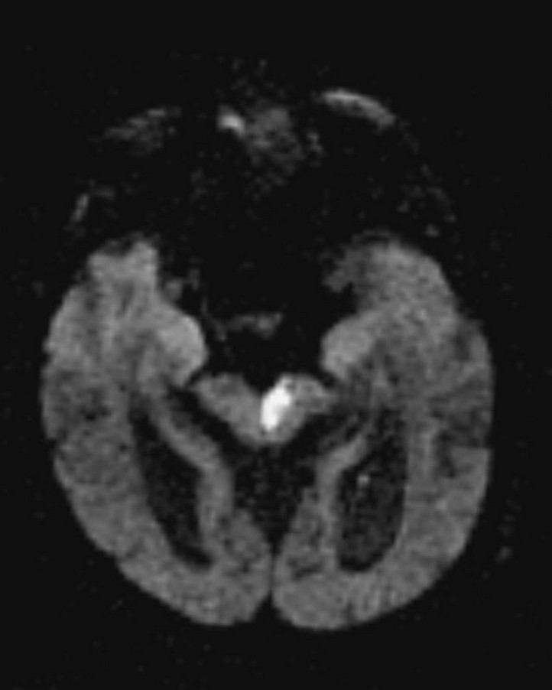
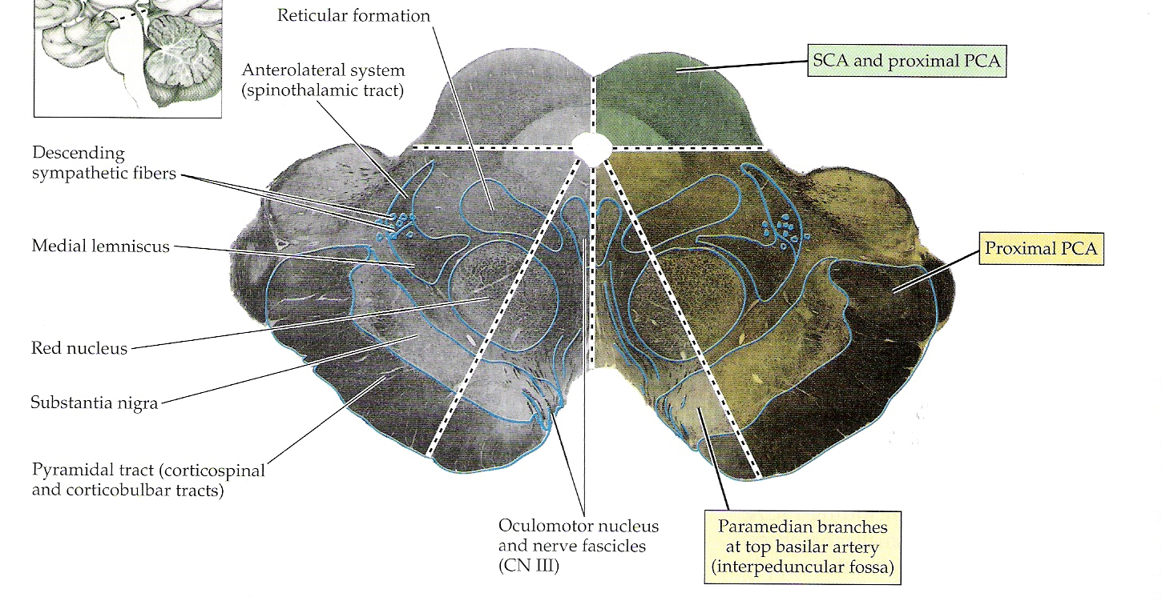

Brainstem Stroke Syndromes Weber Syndrome -Medial Midbrain
Contralateral Face/Arm/Leg weakness
Ipsilateral Oculomotor Palsy
Usually due to peduncular perforating branches off PCA

Slide 37
Brainstem Stroke Syndromes Rule of 4
Practice
A 65 year old man with all the vascular risk factors presents with sudden onset:
Slurred speech
Right sided LMN pattern facial weakness
Right sided arm and leg ataxia
Right sided Horner’s
Left sided pain and temp loss for body
Right sided pain and temp loss for face
Medial or Lateral?
Midbrain, Pons, or Medulla?

Slide 38
Brainstem Stroke Syndromes Rule of 4
Practice
A 65 year old man with all the vascular risk factors presents with sudden onset:
Slurred speech
Right sided LMN pattern facial weakness
Right sided arm and leg ataxia
Right sided Horner’s
Left sided pain and temp loss for body
Right sided pain and temp loss for face
Medial or Lateral?
Midbrain, Pons, or Medulla?
Right lateral pontine

Slide 39
Brainstem Stroke Syndromes Lateral Pontine Syndrome - Marie-Foix syndrome
Deficits are variable due to the AICA and PICA crossover
Usually, an AICA syndrome
Additional and variable deficits can include:
Nausea and vomiting
Vertigo – horizontal and vertical nystagmus
Tinnitus
Deafness
AKA Marie-Foix syndrome

Slide 40
Brainstem Stroke Syndromes Rule of 4
Practice
A 65 year old man with all the vascular risk factors presents with sudden onset:
Rightward gaze palsy
Left sided UMN body weakness
Left sided body vibration/proprioception loss
Medial or Lateral?
Midbrain, Pons, or Medulla?

Slide 41
Brainstem Stroke Syndromes Rule of 4
Practice
A 65 year old man with all the vascular risk factors presents with sudden onset:
Rightward gaze palsy
Left sided UMN body weakness
Left sided body vibration/proprioception loss
Medial or Lateral?
Midbrain, Pons, or Medulla?
Medial Pontine syndrome

Slide 42
Brainstem Stroke Syndromes Medial Pontine Syndrome
Due to occlusion of the paramedian pontine perforating arteries
Deficits include:
Contralateral hemiplegia of body
Ipsilateral horizontal gaze palsy (CN6)
Contralateral vibration/proprioception loss (Medial lemniscus)
Can cause an INO due to involvement of the medial longitudinal fasciculus

Slide 43
Brainstem Stroke Syndromes Rule of 4
Practice
A 65 year old man with all the vascular risk factors presents with sudden onset:
Left sided UMN body weakness
Left sided body vibration/proprioception loss
Right sided tongue weakness (tongue deviates towards the right)
Medial or Lateral?
Midbrain, Pons, or Medulla?

Slide 44
Brainstem Stroke Syndromes Rule of 4
Practice
A 65 year old man with all the vascular risk factors presents with sudden onset:
Left sided UMN body weakness
Left sided body vibration/proprioception loss
Right sided tongue weakness (tongue deviates towards the right)
Medial or Lateral?
Midbrain, Pons, or Medulla?
Medial Medullary Syndrome

Slide 45
Brainstem Stroke Syndromes Medial Medullary Syndrome – Alternating Hemiplegia
Due to occlusion of the paramedian branches of the vertebrals or the anterior spinal artery
Called alternating hemiplegia because of the crossed motor deficits
Deficits include:
Contralateral hemiplegia of body
Contralateral vibration/proprioception loss (Medial lemniscus)
Ipsilateral LMN tongue weakness (CN12)

Slide 46
Brainstem Stroke Syndromes Rule of 4
Practice
A 65 year old man with all the vascular risk factors presents with sudden onset:
Right sided ataxia
Left sided body pain and temperature sensation loss
Right sided facial pain and temperature sensation loss
Right sided Horner’s syndrome
Dysarthria
Flattened palate on the right
Medial or Lateral?
Midbrain, Pons, or Medulla?

Slide 47
Brainstem Stroke Syndromes Rule of 4
Practice
A 65 year old man with all the vascular risk factors presents with sudden onset:
Right sided ataxia
Left sided body pain and temperature sensation loss
Right sided facial pain and temperature sensation loss
Right sided Horner’s syndrome
Dysarthria
Flattened palate on the right
Medial or Lateral?
Midbrain, Pons, or Medulla?
Right Lateral Medulla

Slide 48
Brainstem Stroke Syndromes Lateral Medullary Syndrome – Wallenberg’s
Due to occlusion of the vertebral or PICA
Deficits include:
No CST findings
Ipsilateral nucleus ambiguous lesion - flattened palate, dysarthria
Ipsilateral ataxia
Ipsilateral pain and temp loss in the face
Contralateral pain and temp loss in the body

